Slide 1
MET CS 555 – Foundations of Machine Learning Lecture 12: Logistic Regression
Hongsheng Wu
Boston University

Slide 2
Study Guide
Logistic Regression
Interpretation of Logistic Regression Results
Formal Inference in Logistic Regression
Model Fitness in Logistic Regression
Receiver Operating Characteristic Curve (ROC Curve)

Slide 3
Logistic Regression

Slide 4
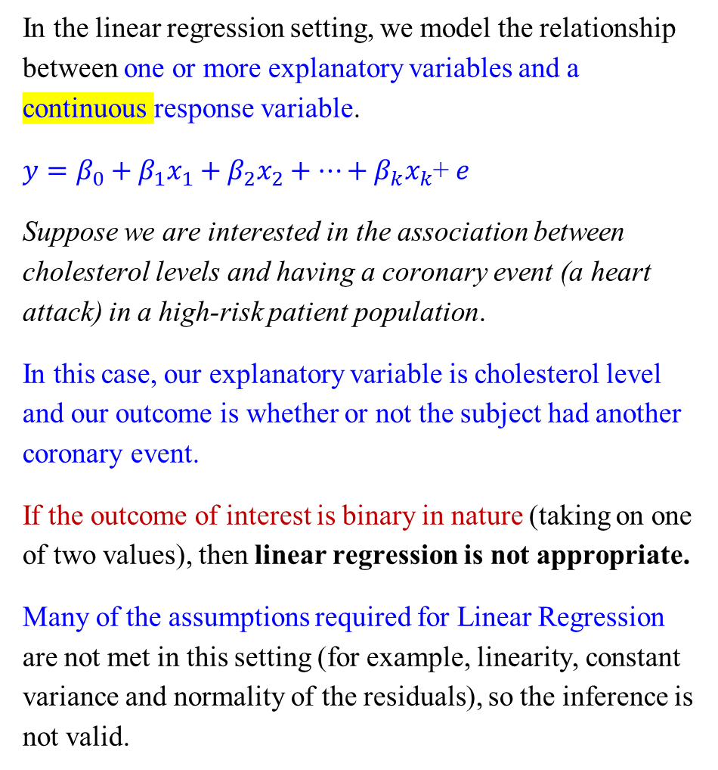
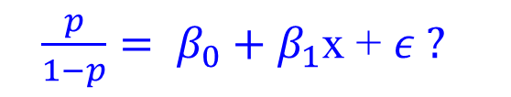

Logistic Regression
In the linear regression setting, we model the relationship between one or more explanatory variables and a continuous response variable.
$y=β_{0}+β_{1}x_{1}+β_{2}x_{2}+…+β_{k}x_{k}$+ $e$
Suppose we are interested in the association between cholesterol levels and having a coronary event (a heart attack) in a high-risk patient population.
In this case, our explanatory variable is cholesterol level and our outcome is whether or not the subject had another coronary event.
If the outcome of interest is binary in nature (taking on one of two values), then linear regression is not appropriate.
Many of the assumptions required for Linear Regression are not met in this setting (for example, linearity, constant variance and normality of the residuals), so the inference is not valid.
What to do?
Use odds $\frac{p}{1−p}$?
$\frac{p}{1−p}= β_{0}+β_{1}$x + $ε ?$

Slide 5
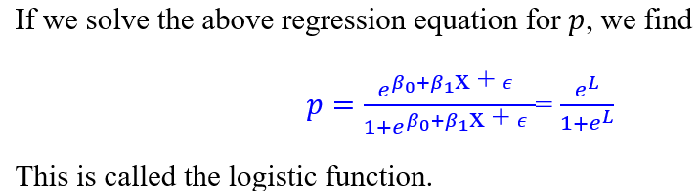
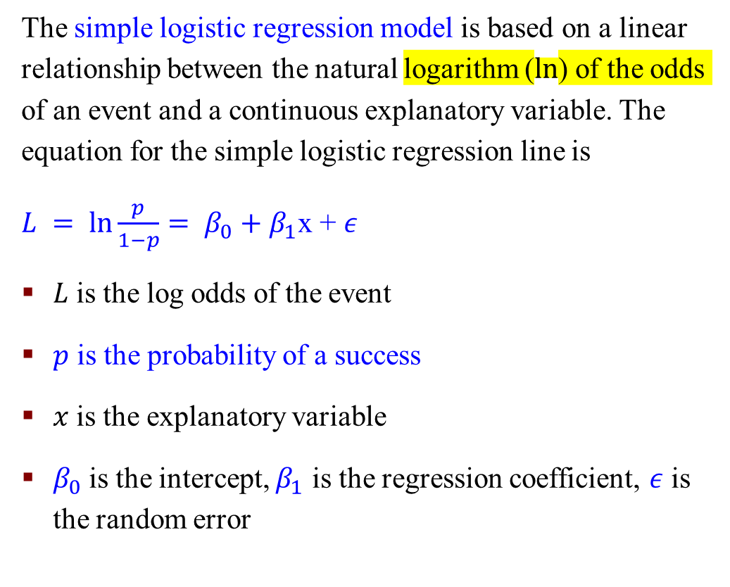
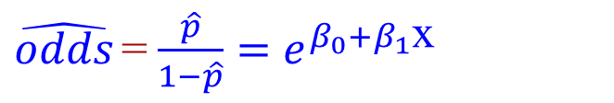
Simple Logistic Regression
The simple logistic regression model is based on a linear relationship between the natural logarithm ($ln$) of the odds of an event and a continuous explanatory variable. The equation for the simple logistic regression line is
$L = ln\frac{p}{1−p}= β_{0}+β_{1}$x + $ε$
$L$ is the log odds of the event
$p$ is the probability of a success
$x$ is the explanatory variable
$β_{0}$is the intercept, $β_{1}$ is the regression coefficient, $ε$ is the random error
$\hat{odds}$= $\frac{\hat{p}}{1−\hat{p}}=$ $e^{β_{0}+β_{1}\text{x} }$
Notes:
$ε$ Epsilon

Slide 6
Interpretation of Logistic Regression Results

Slide 7
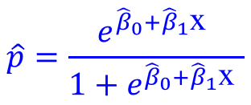
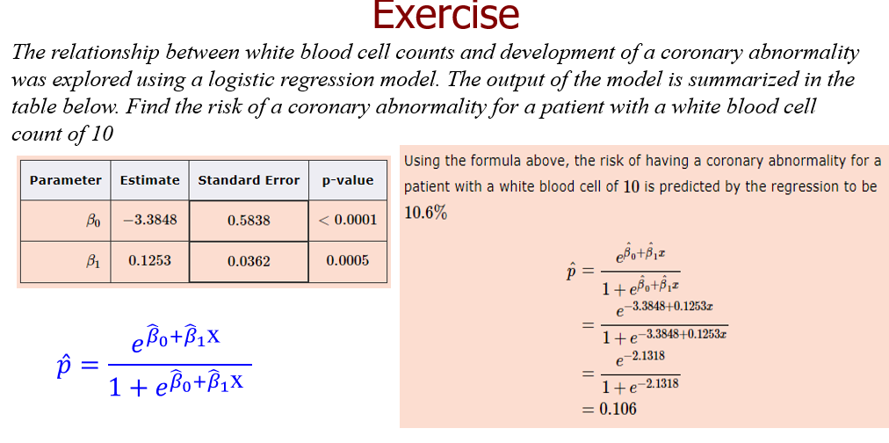

Interpretation: Probability
Using the estimates of the regression coefficients ${\hat{β}}_{0}$and ${\hat{β}}_{1}$, we can predict the risk (probability) of the outcome of interest for a given value of $x$ using the following equation:

Slide 8
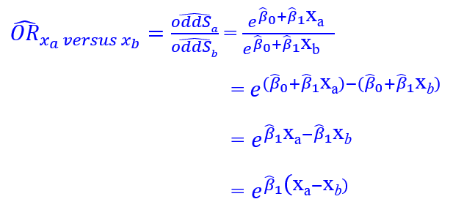
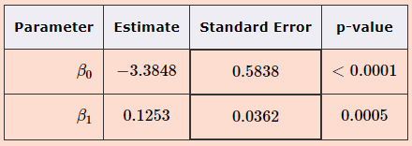
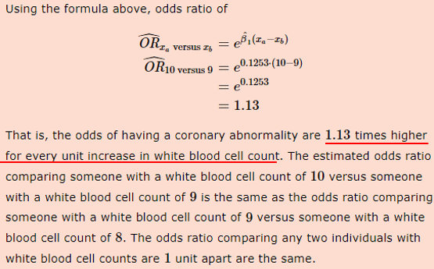

Interpretation: Odds Ratio
Using the estimates of the regression coefficients ${\hat{β}}_{0}$and ${\hat{β}}_{1}$, we can estimate the odds ratio of the outcome of interest for a given value of $x = xa$ versus a given value of $x = xb$ using the following equation:
Use these to calculate the odds ratio for a coronary abnormality for someone with a white blood cell count of 10 versus a white blood cell count of 9

Slide 9
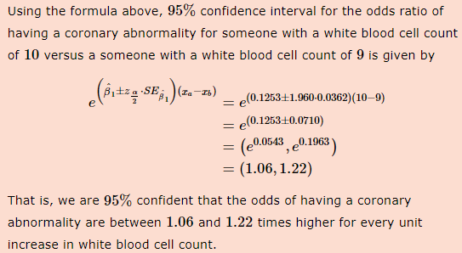
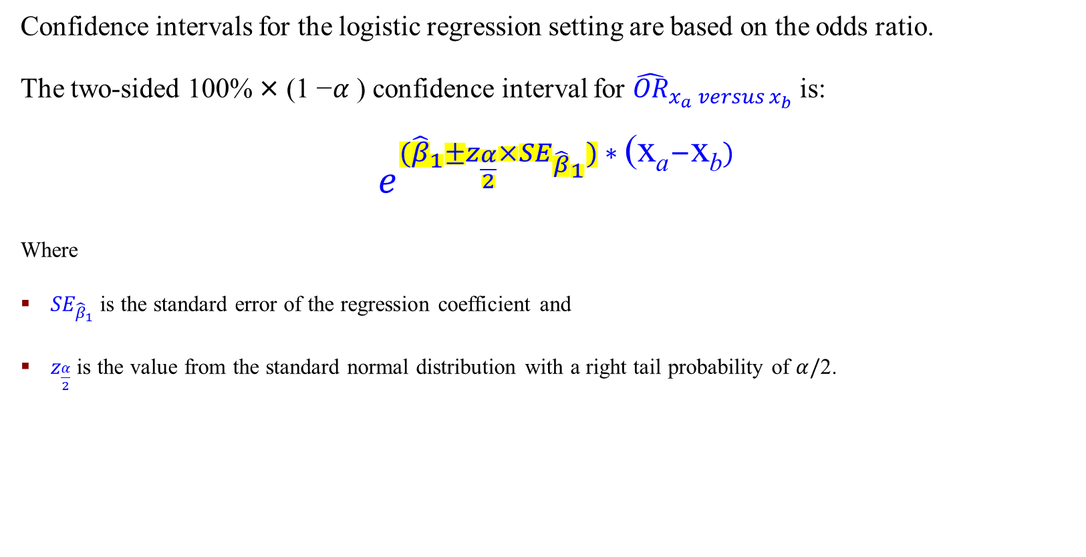
Interpretation: Confidence Interval
Confidence intervals for the logistic regression setting are based on the odds ratio.
The two-sided 100% × (1 −$α$ ) confidence interval for ${\hat{OR}}_{x_{a} versus x_{b}}$is:
$e^{{(\hat{β}}_{1}±z_{\frac{α}{2}}×{SE}_{{\hat{β}}_{1}}) ∗ \text{(}\text{x}\text{a}−\text{x}\text{b})}$
Where
${SE}_{{\hat{β}}_{1}}$is the standard error of the regression coefficient and
$z_{\frac{α}{2}}$is the value from the standard normal distribution with a right tail probability of $α/$2.
Calculate the 95% confidence interval for the odds ratio for a coronary abnormality for someone with a white blood cell count of 10 versus a white blood cell count of 9.

Slide 10
An Example: Logistic Regression
We are interested in the association between cholesterol levels and coronary events in a high-risk patient population (who have had an event in the past). We collect cholesterol data for 50 subjects and then follow each for a year to see if they have another coronary event.
The explanatory variable is cholesterol level, and our outcome is whether or not the subject had another coronary event.
Given the nature of our response variable, we perform a logistic regression. A summary of the beta estimates from the model is shown below.
predict the risk of another coronary event for a high-risk patient with a cholesterol level of 190
calculate the odds ratio for a coronary event of a high-risk patient with a cholesterol level of 190 versus a patient with a cholesterol level of 180
calculate 95% confidence interval for the odds ratio of having a coronary event for a patient with a cholesterol level of 190 versus a patient with a cholesterol level of 180.

Slide 11
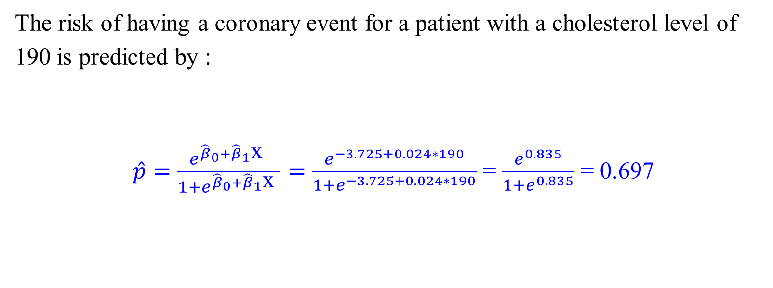
An Example: Logistic Regression
The risk of having a coronary event for a patient with a cholesterol level of 190 is predicted by :
$\hat{p}=\frac{e^{{\hat{β}}_{0}+{\hat{β}}_{1}\text{x} }}{1+e^{{\hat{β}}_{0}+{\hat{β}}_{1}\text{x} }}=\frac{e^{−3.725+0.024∗190}}{1+e^{−3.725+0.024∗190}}$ = $\frac{e^{0.835}}{1+e^{0.835}}$ = 0.697

Slide 12
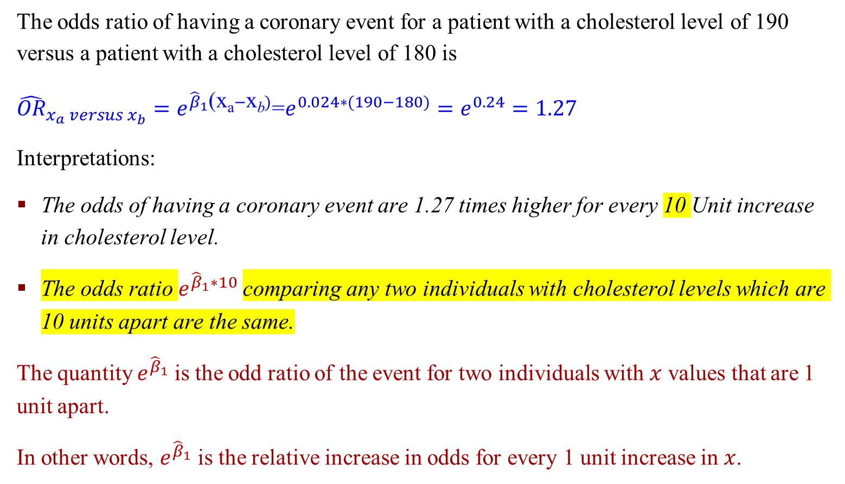
An Example: Logistic Regression
The odds ratio of having a coronary event for a patient with a cholesterol level of 190 versus a patient with a cholesterol level of 180 is
${\hat{OR}}_{x_{a} versus x_{b}}=e^{{\hat{β}}_{1}\text{(}\text{x}\text{a}−\text{x}\text{b})}$=$e^{0.024∗(190−180)}=e^{0.24}=1.27$
Interpretations:
The odds of having a coronary event are 1.27 times higher for every 10 Unit increase in cholesterol level.
The odds ratio $e^{{\hat{β}}_{1}∗10}$comparing any two individuals with cholesterol levels which are 10 units apart are the same.
The quantity $e^{{\hat{β}}_{1}}$is the odd ratio of the event for two individuals with $x$ values that are 1 unit apart.
In other words, $e^{{\hat{β}}_{1}}$ is the relative increase in odds for every 1 unit increase in $x$.

Slide 13
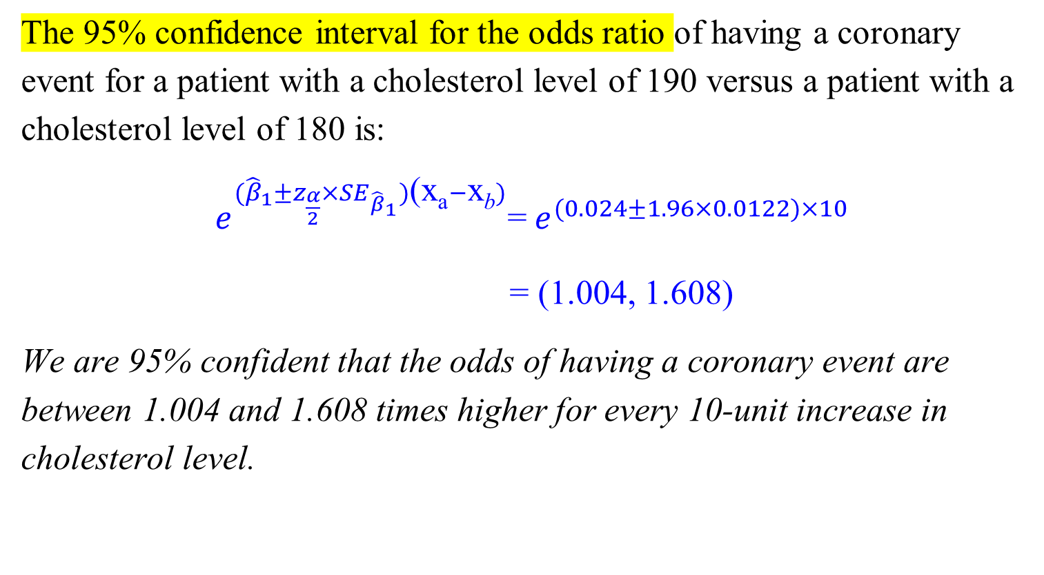
An Example: Logistic Regression
The 95% confidence interval for the odds ratio of having a coronary event for a patient with a cholesterol level of 190 versus a patient with a cholesterol level of 180 is:
$e^{{(\hat{β}}_{1}±z_{\frac{α}{2}}×{SE}_{{\hat{β}}_{1}})\text{(}\text{x}\text{a}−\text{x}\text{b})}$=${ e}^{(0.024±1.96×0.0122)×10}$
= (1.004, 1.608)
We are 95% confident that the odds of having a coronary event are between 1.004 and 1.608 times higher for every 10-unit increase in cholesterol level.

Slide 14
Generalized Linear Models (GLMs)
We can use ANY stochastic process for generating the error, not just normal distribution
GLM is an extension of linear regression that allows errors to be generated by various distributions
In particular, any distributions in the “Exponential Family”
GLMs extend the linear modeling capability of R to scenarios that involve non-normal error distributions. The idea is to obtain the predictor variables' linear functions by transforming the equation's right side with a link function

Slide 15
Formal Inference in Logistic Regression

Slide 16
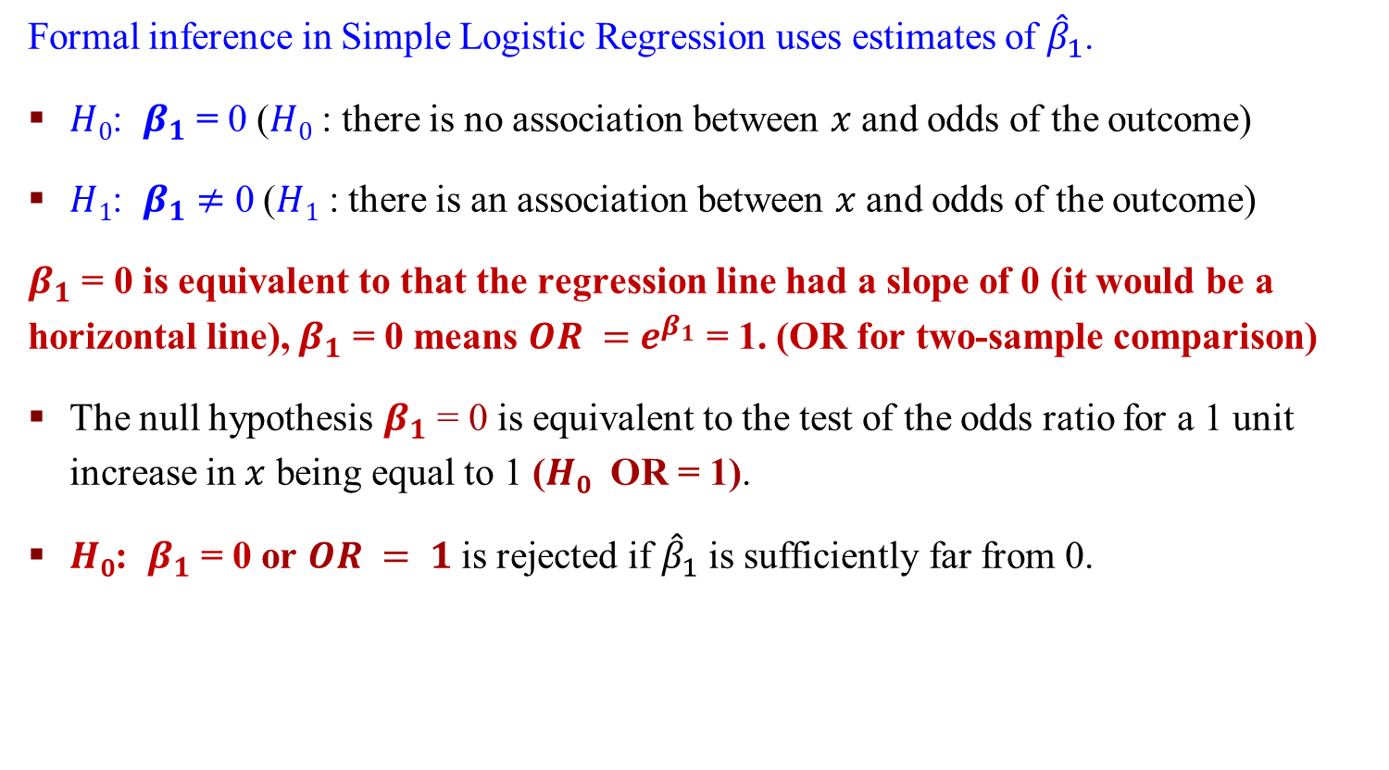
Formal Inference in Simple Logistic Regression
Formal inference in Simple Logistic Regression uses estimates of ${\hat{β}}_{1}$.
$H0$: $β_{1}$ = 0 ($H0$ : there is no association between $x$ and odds of the outcome)
$H1$: $β_{1}$ $≠$ 0 ($H1$ : there is an association between $x$ and odds of the outcome)
$β_{1}$ = 0 is equivalent to that the regression line had a slope of 0 (it would be a horizontal line), $β_{1}$ = 0 means $OR =$ $e^{β_{1}}$ = 1. (OR for two-sample comparison)
The null hypothesis $β_{1}$ = 0 is equivalent to the test of the odds ratio for a 1 unit increase in $x$ being equal to 1 ($H0$ OR = 1).
$H0$: $β_{1}$ = 0 or $OR = 1$is rejected if ${\hat{β}}_{1}$ is sufficiently far from 0.

Slide 17
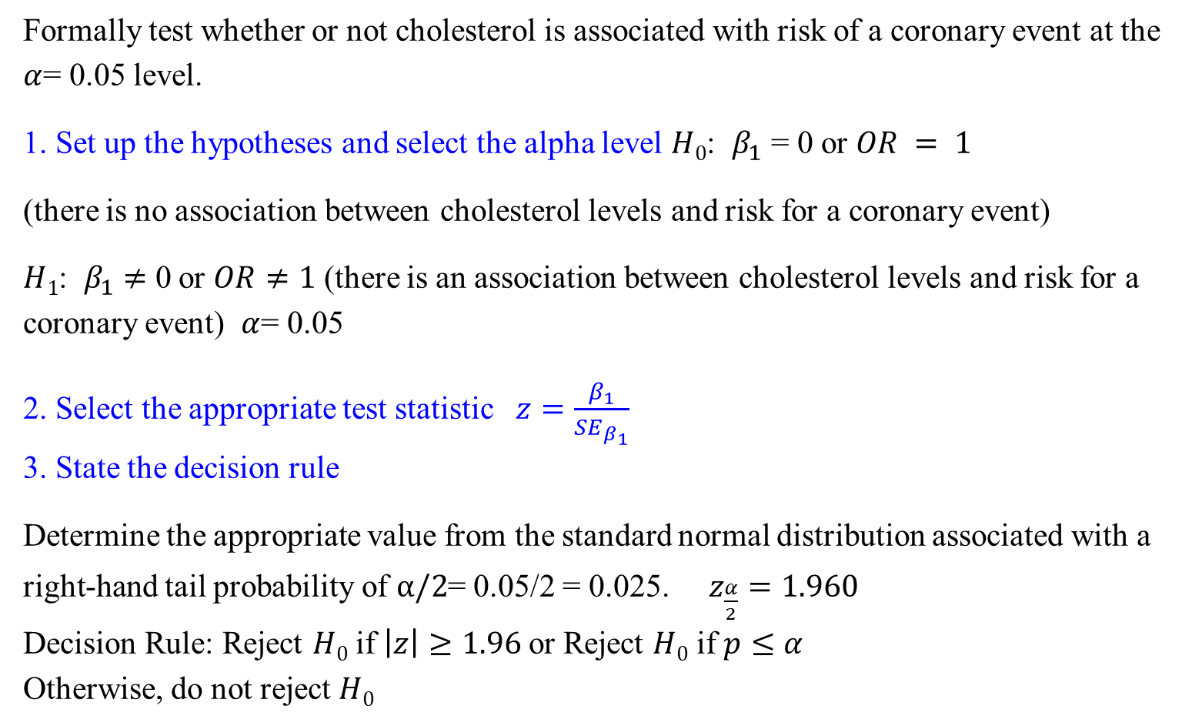
An Example: Logistic Regression Inference
Formally test whether or not cholesterol is associated with risk of a coronary event at the $α$= 0.05 level.
1. Set up the hypotheses and select the alpha level $H0$: $β_{1}$ = 0 or $OR = 1$
(there is no association between cholesterol levels and risk for a coronary event)
$H1$: $β_{1}$ $≠$ 0 or $OR≠1$ (there is an association between cholesterol levels and risk for a coronary event) $α$= 0.05
2. Select the appropriate test statistic $z=\frac{β_{1}}{{SE}_{β_{1}}}$
3. State the decision rule
Determine the appropriate value from the standard normal distribution associated with a right-hand tail probability of $α/2$= 0.05/2 = 0.025. $z_{\frac{α}{2}}=1.960$
Decision Rule: Reject $H0$ if $\left|z\right|≥1.96$or Reject $H0$ if $p≤α$
Otherwise, do not reject $H0$

Slide 18
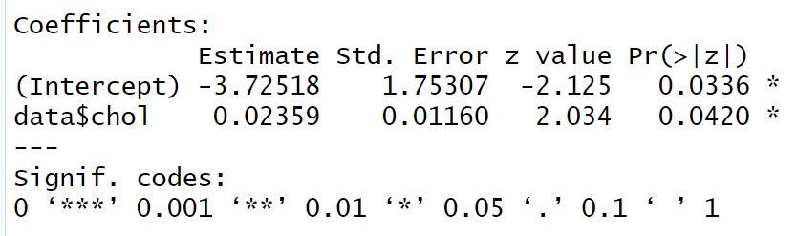
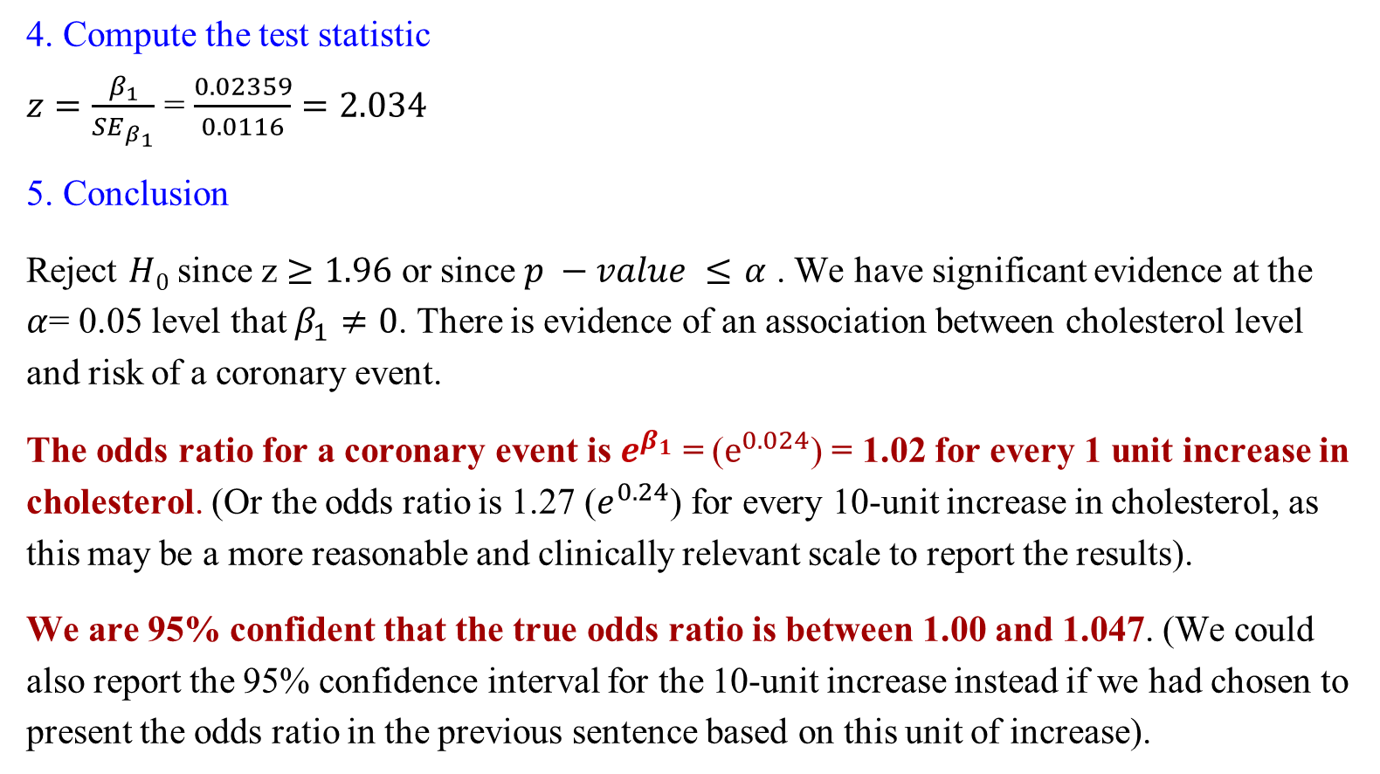
An Example: Logistic Regression Inference
4. Compute the test statistic
$z=\frac{β_{1}}{{SE}_{β_{1}}}$ = $\frac{0.02359}{0.0116}=2.034$
5. Conclusion
Reject $H0$ since z $≥1.96$ or since $p −value ≤$ $α$ . We have significant evidence at the $α$= 0.05 level that $β_{1}≠0$. There is evidence of an association between cholesterol level and risk of a coronary event.
The odds ratio for a coronary event is $e^{β_{1}}$ = ($e^{0.024}$) = 1.02 for every 1 unit increase in cholesterol. (Or the odds ratio is 1.27 ($e^{0.24}$) for every 10-unit increase in cholesterol, as this may be a more reasonable and clinically relevant scale to report the results).
We are 95% confident that the true odds ratio is between 1.00 and 1.047. (We could also report the 95% confidence interval for the 10-unit increase instead if we had chosen to present the odds ratio in the previous sentence based on this unit of increase).

Slide 19
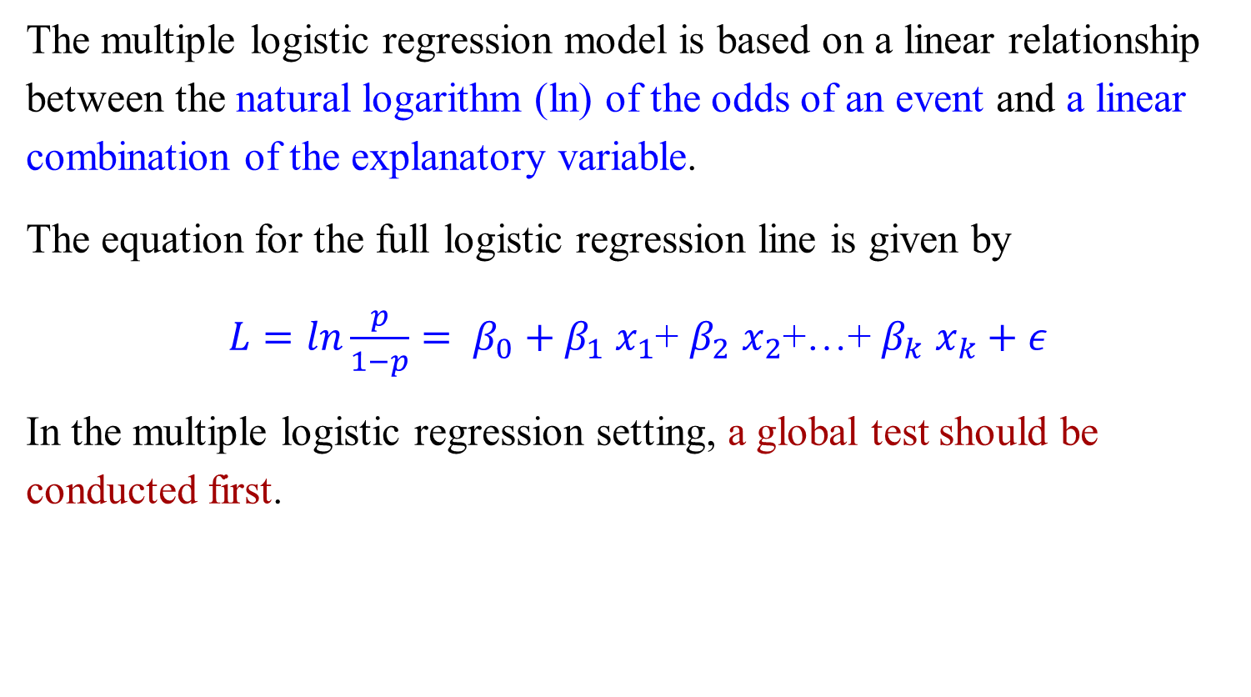
Multiple Logistic Regression
The multiple logistic regression model is based on a linear relationship between the natural logarithm (ln) of the odds of an event and a linear combination of the explanatory variable.
The equation for the full logistic regression line is given by
$L=ln\frac{p}{1−p}= β_{0}+β_{1}$ $x_{1}$+ $β_{2}$ $x_{2}$+…+ $β_{k}$ $x_{k}+ε$
In the multiple logistic regression setting, a global test should be conducted first.

Slide 20
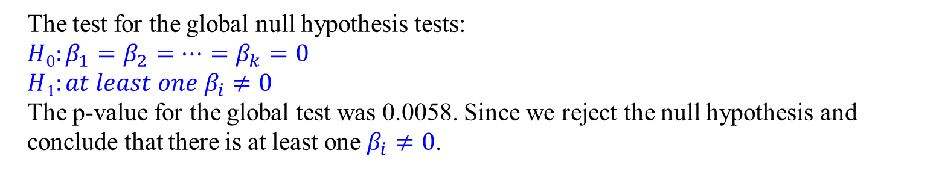

An Example: Multiple Logistic Regression
Our explanatory variables are cholesterol level, age, and gender, and our outcome is whether or not the subject had another coronary event
The p-value for the global test was 0.0058.
A summary of the beta estimates from the model are shown below. Test the global null hypothesis at the $α$= 0.05 level.
The test for the global null hypothesis tests:
$$H0:β_{1}=β_{2}=…=β_{k}=0$$
$$H1:at least one β_{i}≠0$$
The p-value for the global test was 0.0058. Since we reject the null hypothesis and conclude that there is at least one $β_{i}≠0$.

Slide 21
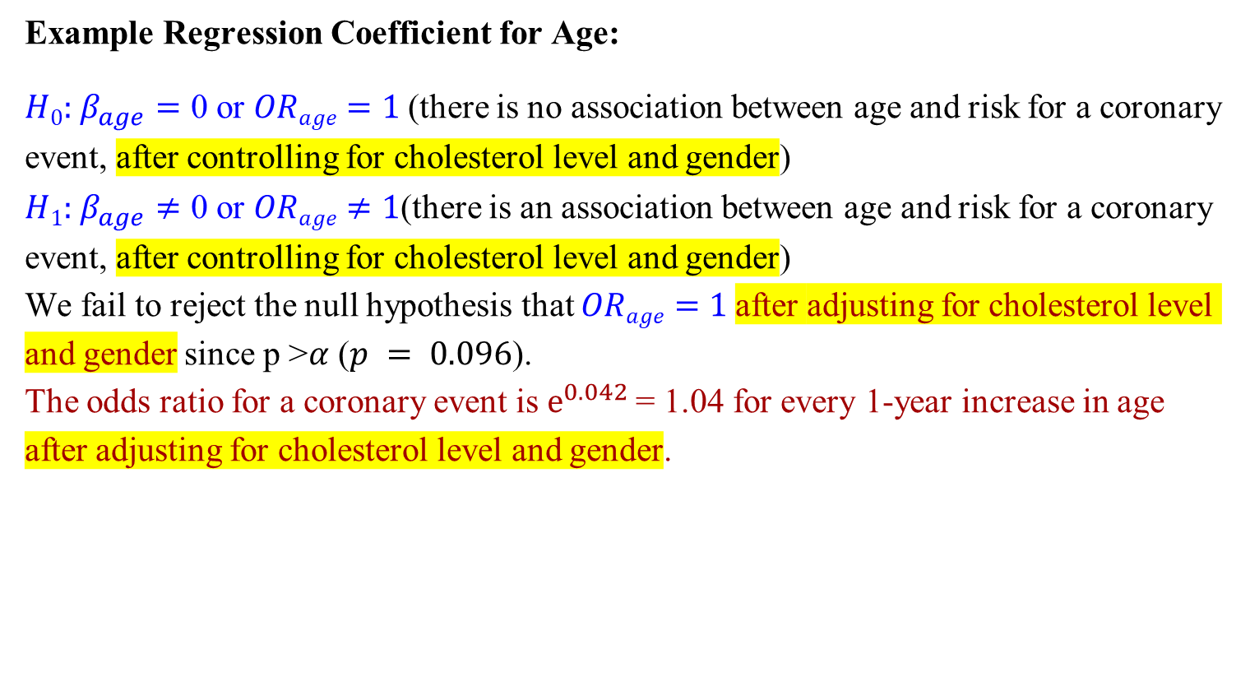
An Example: Multiple Logistic Regression
Example Regression Coefficient for Age:
$H0:$ $β_{age}=$ 0 or $ORage=1$(there is no association between age and risk for a coronary event, after controlling for cholesterol level and gender)
$H1:$ $β_{age}≠$ 0 or $ORage≠1$(there is an association between age and risk for a coronary event, after controlling for cholesterol level and gender)
We fail to reject the null hypothesis that $ORage=1$after adjusting for cholesterol level and gender since p >$α$ ($p = 0.096$).
The odds ratio for a coronary event is $e^{0.042}$= 1.04 for every 1-year increase in age after adjusting for cholesterol level and gender.

Slide 22
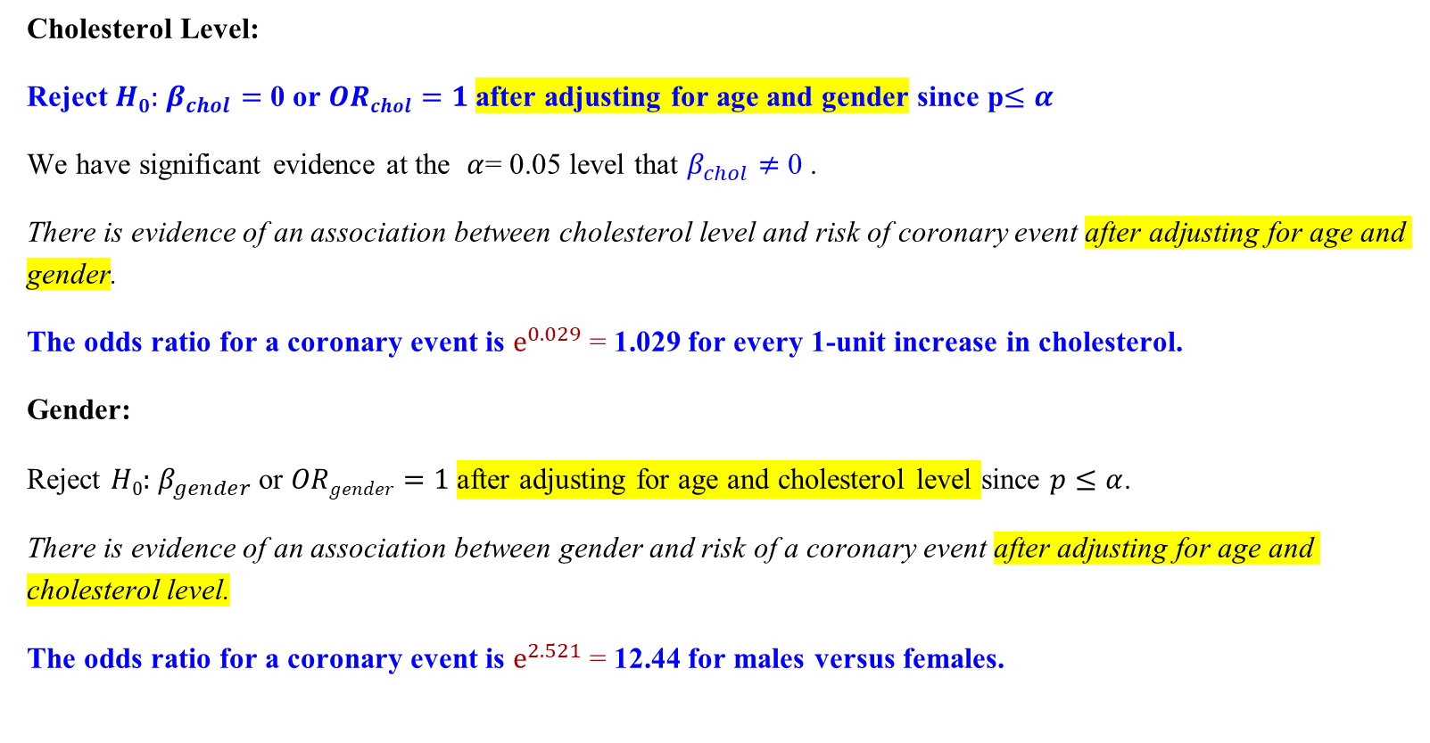
An Example: Multiple Logistic Regression
Cholesterol Level:
Reject $H0:$ $β_{chol}=$ 0 or $ORchol=1$after adjusting for age and gender since p$≤α$
We have significant evidence at the $α$= 0.05 level that $β_{chol}≠$ 0 .
There is evidence of an association between cholesterol level and risk of coronary event after adjusting for age and gender.
The odds ratio for a coronary event is $e^{0.029}$= 1.029 for every 1-unit increase in cholesterol.
Gender:
Reject $H0:$ $β_{gender}$or $ORgender=1$after adjusting for age and cholesterol level since $p≤α$.
There is evidence of an association between gender and risk of a coronary event after adjusting for age and cholesterol level.
The odds ratio for a coronary event is $e^{2.521}$= 12.44 for males versus females.

Slide 23
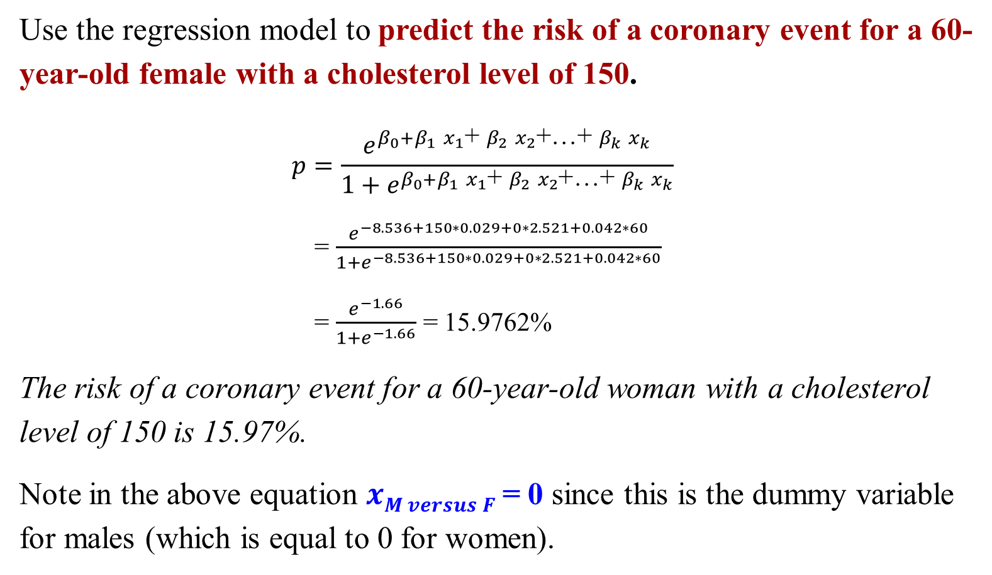
An Example: Multiple Logistic Regression
Use the regression model to predict the risk of a coronary event for a 60-year-old female with a cholesterol level of 150.
$$p=\frac{e^{β_{0}+β_{1} x_{1}\text{+ }β_{2} x_{2}\text{+…+ }β_{k} x_{k}}}{1+e^{β_{0}+β_{1} x_{1}\text{+ }β_{2} x_{2}\text{+…+ }β_{k} x_{k}}}$$
= $\frac{e^{−8.536+150∗0.029+0∗2.521+0.042∗60}}{1+e^{−8.536+150∗0.029+0∗2.521+0.042∗60}}$
= $\frac{e^{−1.66}}{1+e^{−1.66}}$ = 15.9762%
The risk of a coronary event for a 60-year-old woman with a cholesterol level of 150 is 15.97%.
Note in the above equation $xM versus F$= 0 since this is the dummy variable for males (which is equal to 0 for women).

Slide 24
Model Fitness in Logistic Regression

Slide 25
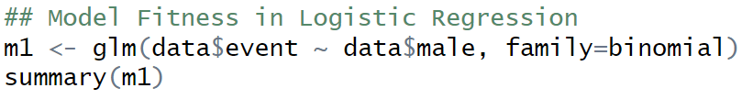
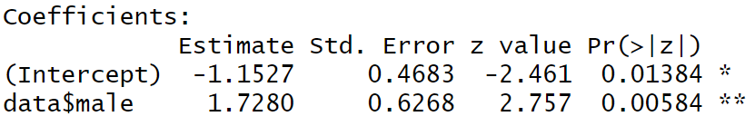
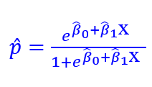
Predictions of Logistic Regression
In the logistic regression setting, the observed response takes on one of two values (0 = no event and 1= event).
The predicted probabilities take on values between 0 and 1.
If the predicted probabilities for someone who had the event are close to or equal to 1, then we would say that the model successfully predicted that individual's risk.
= $\frac{e^{−1.1527+1.7280∗1}}{1+e^{−1.1527+1.7280∗1}}$ for Male; $\frac{e^{−1.1527+1.7280∗0}}{1+e^{−1.1527+1.7280∗0}}$for Female

Slide 26
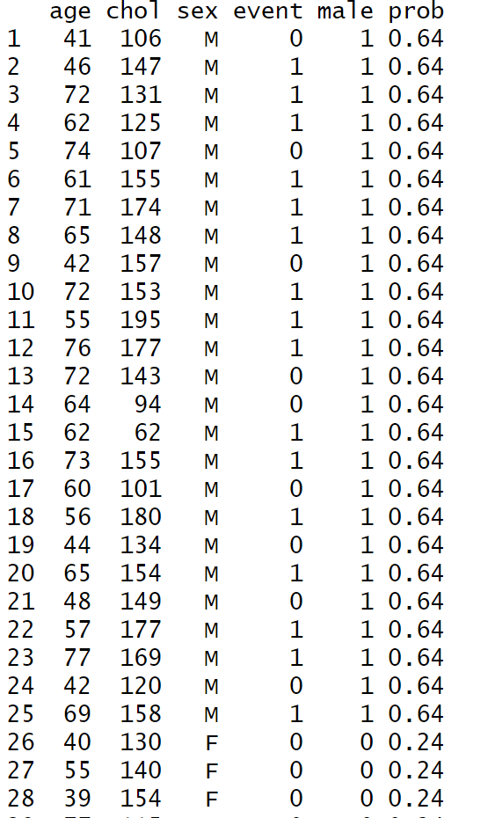
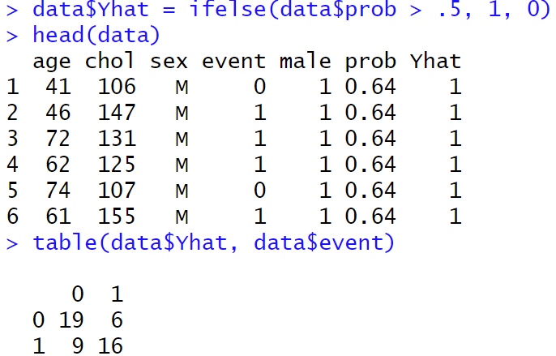
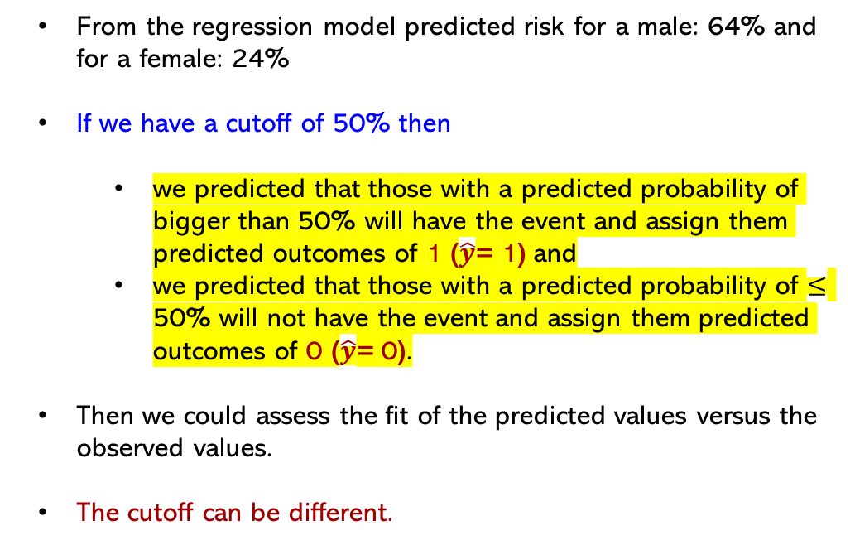
How to Quantify the Fitness in Logistic Regression
From the regression model predicted risk for a male: 64% and for a female: 24%
If we have a cutoff of 50% then
we predicted that those with a predicted probability of bigger than 50% will have the event and assign them predicted outcomes of 1 ($\hat{y}$= 1) and
we predicted that those with a predicted probability of $≤$ 50% will not have the event and assign them predicted outcomes of 0 ($\hat{y}$= 0).
Then we could assess the fit of the predicted values versus the observed values.
The cutoff can be different.

Slide 27
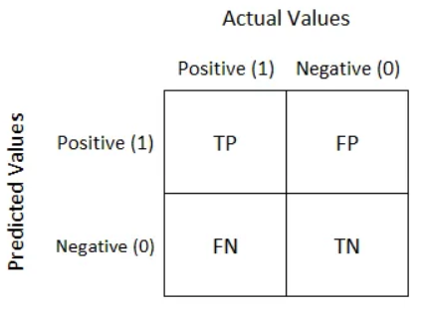
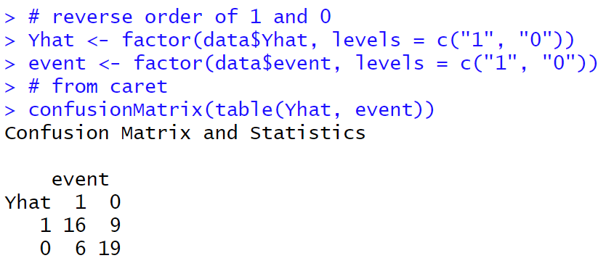
True/False Positive and True/False Negative
True positive. Rate of Correct identification of Positive category
Example: Sick people correctly identified as sick
False positive. Rate of Incorrect identification of Positive category
Example: Healthy people incorrectly identified as sick
True negative. Rate of Correct identification of Negative category
Example: Healthy people correctly identified as healthy
False negative. Rate of Incorrect identification of Negative category
Example: Sick people incorrectly identified as healthy
In general, Positive = identified and negative = rejected.
Therefore:
True positive = correctly identified
False positive = incorrectly identified
True negative = correctly rejected
False negative = incorrectly rejected

Slide 28
Example – Confusion Matrix
We have identified 30 sick people correctly identified as sick
We have identified 4 healthy people incorrectly identified as sick
We have identified 25 healthy people correctly identified as healthy
We have identified 3 sick people incorrectly identified as healthy
True Positive: 30
False Positive: 4
True Negative: 25
False Negative: 3

Slide 29
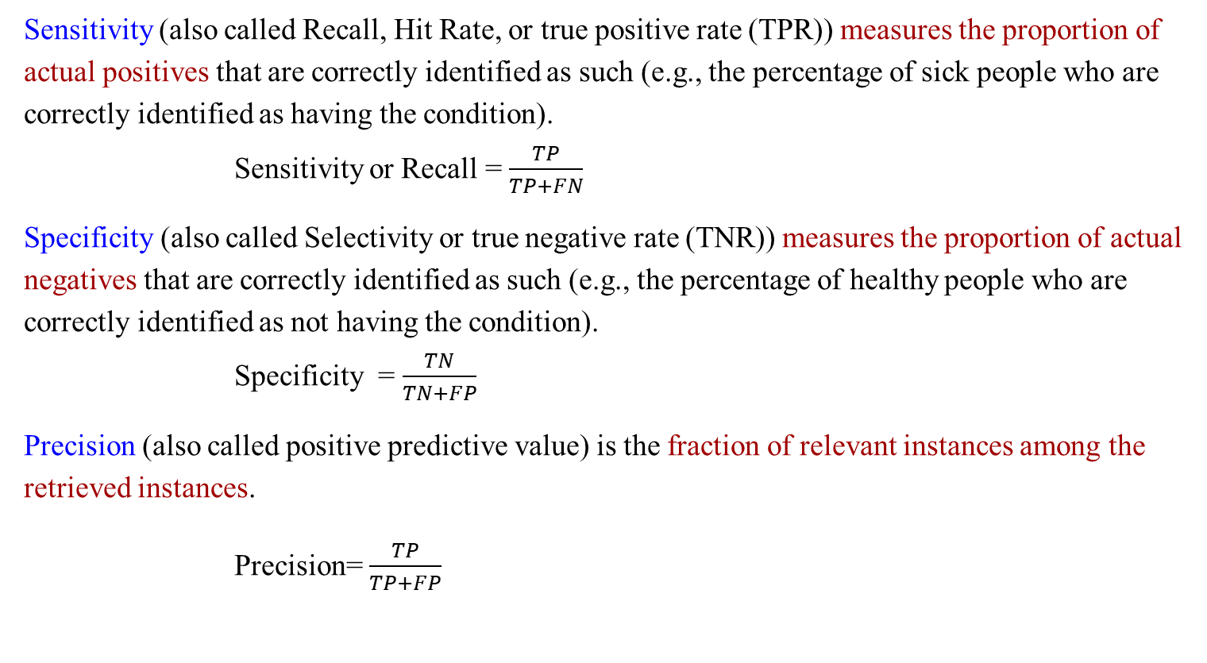
Sensitivity & Specificity & Precision
Sensitivity (also called Recall, Hit Rate, or true positive rate (TPR)) measures the proportion of actual positives that are correctly identified as such (e.g., the percentage of sick people who are correctly identified as having the condition). Sensitivity or Recall = $\frac{TP}{TP+FN}$
Specificity (also called Selectivity or true negative rate (TNR)) measures the proportion of actual negatives that are correctly identified as such (e.g., the percentage of healthy people who are correctly identified as not having the condition). Specificity = $\frac{TN}{TN+FP}$
Precision (also called positive predictive value) is the fraction of relevant instances among the retrieved instances.
Precision= $\frac{TP}{TP+FP}$

Slide 30
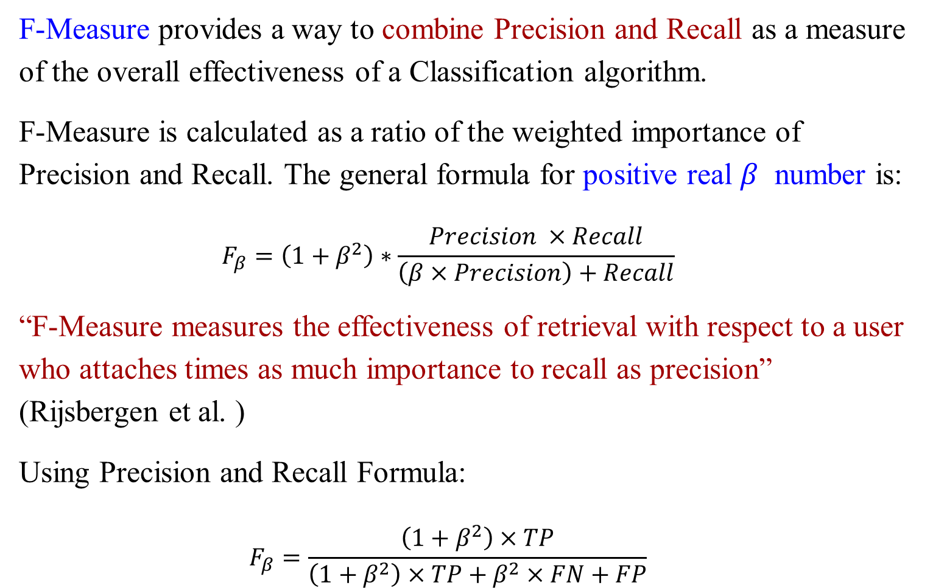
F-Measure & F1 Measure
F-Measure provides a way to combine Precision and Recall as a measure of the overall effectiveness of a Classification algorithm.
F-Measure is calculated as a ratio of the weighted importance of Precision and Recall. The general formula for positive real $β$ number is:
$$F_{β}=\left(1+β^{2}\right)∗\frac{Precision ×Recall}{\left(β×Precision\right)+Recall}$$
“F-Measure measures the effectiveness of retrieval with respect to a user who attaches times as much importance to recall as precision” (Rijsbergen et al. )
Using Precision and Recall Formula:
$$F_{β}=\frac{\left(1+β^{2}\right)×TP}{\left(1+β^{2}\right)×TP+β^{2}×FN+FP}$$
Notes:
$β$ =1, 2, 0.5

Slide 31
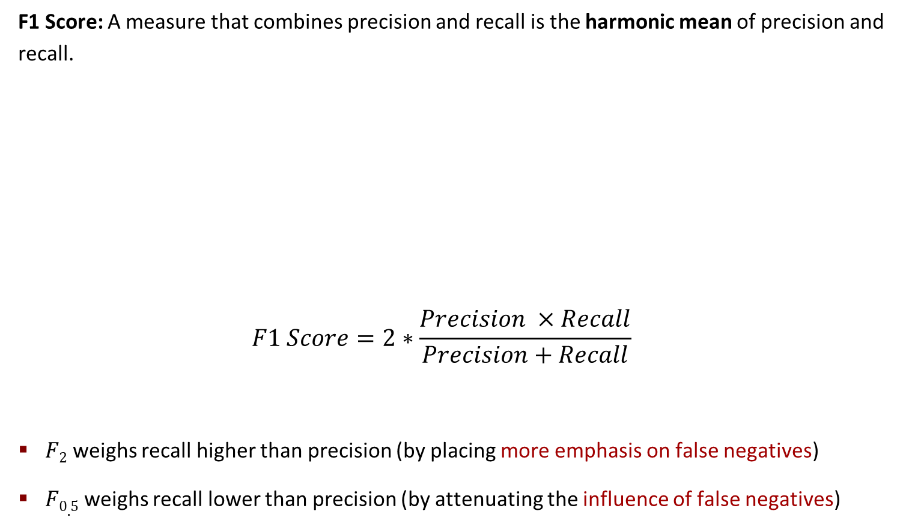
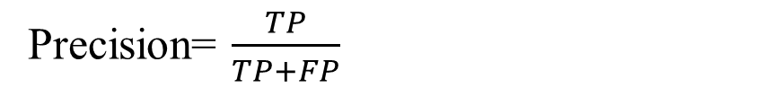

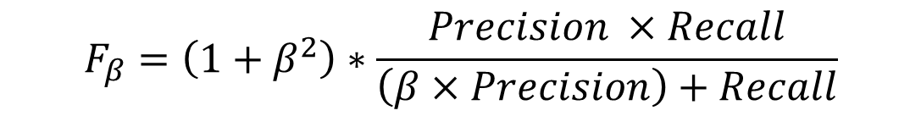
F1 Measure, F2, F0.5
F1 Score: A measure that combines precision and recall is the harmonic mean of precision and recall.
$$F1 Score=2∗\frac{Precision ×Recall}{Precision+Recall}$$
$F2$ weighs recall higher than precision (by placing more emphasis on false negatives)
$F0.5$ weighs recall lower than precision (by attenuating the influence of false negatives)
$$F_{β}=\left(1+β^{2}\right)∗\frac{Precision ×Recall}{\left(β×Precision\right)+Recall}$$
Sensitivity or Recall = $\frac{TP}{TP+FN}$
Precision= $\frac{TP}{TP+FP}$
Notes:
harmonic谐波
attenuating衰减

Slide 32
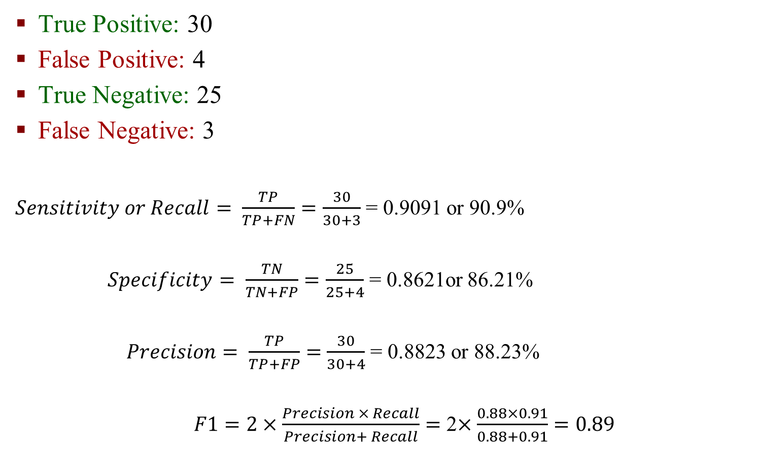
Example
True Positive: 30
False Positive: 4
True Negative: 25
False Negative: 3
$Sensitivity or Recall= \frac{TP}{TP+FN}=\frac{30}{30+3}$ = 0.9091 or 90.9%
$Specificity= \frac{TN}{TN+FP}=\frac{25}{25+4}$ = 0.8621or 86.21%
$Precision= \frac{TP}{TP+FP}=$ $\frac{30}{30+4}$ = 0.8823 or 88.23%
$F1=2×\frac{Precision × Recall}{Precision+ Recall}=$ 2$×\frac{0.88×0.91}{0.88+0.91}=0.89$

Slide 33
Receiver Operating Characteristic Curve (ROC Curve)

Slide 34
ROC (Receiver Operating Characteristic)
Sensitivity and specificity are important measures in assessing the fit of a logistic regression model.
Models with one or more continuous explanatory or independent variables have more possible values for the predicted probabilities. Therefore, many cutoffs often produce distinct values of sensitivity and specificity.
The area under the ROC (receiver operating characteristic) curve (also known as the c-statistic) measures the sensitivity and specificity across the range of all possible cutoffs.
It is used to measure the goodness of fit of a logistic regression model.

Slide 35
ROC (Receiver Operating Characteristic)
The ROC curve is a plot of corresponding pairs of sensitivity (y-axis) and 1 minus the specificity (x-axis) for each possible cutoff point.
It ranges between 0.5 and 1.0 with larger values indicating a better fit.
When the area under the curve is equal to 0.50, it is said that the model does no better at classifying events than at random or by chance.

